Slide 1
Analysis of Ionospheric Variability in EDGES Observations
Katie Herrington
Dr. Judd Bowman
Arizona Space Grant Symposium
April 23, 2022
Notes:
Remember to introduce yourself in the beginning of presentation. Name, school, majors, title of presentation and go.

Slide 2
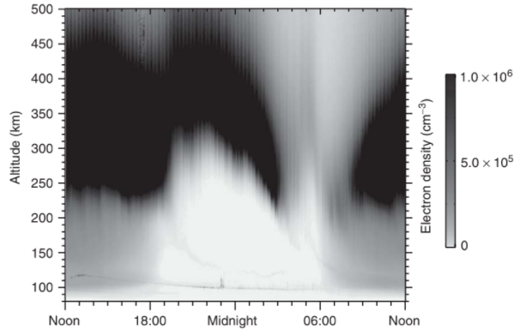
Background
Earth’s ionosphere is formed when high energy photons ionize Earth’s upper atmosphere, leaving behind a layer of ionization
These charged particles cause absorption of astronomical radio waves
Electrons in the hot, ionized plasma emit radio waves
Density of plasma changes throughout the day
Arecibo example
Kelley, M. C. (2009). The Earth's ionosphere: Plasma physics and Electrodynamics. Boston: Academic Press.

Slide 3
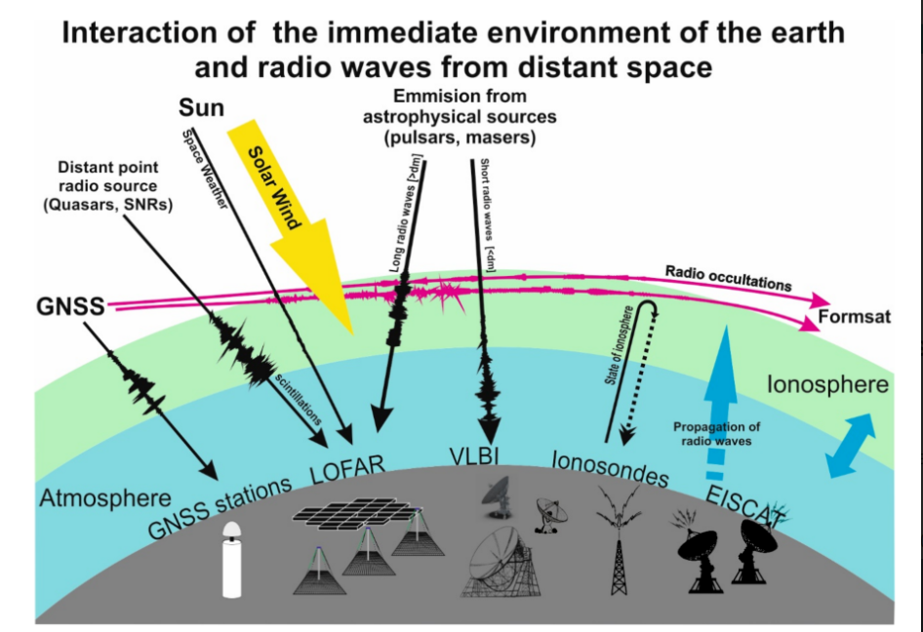
Goal
Track how the ionosphere and number of charged particles in the atmosphere change with time
Get better idea of how Earth’s ionosphere affects how radio telescopes on Earth measure astronomical radio waves
Błaszkiewicz LP, Flisek P, Kotulak K, Krankowski A, Lewandowski W, Kijak J, Froń A. Finding the Ionospheric Fluctuations Reflection in the Pulsar Signals’ Characteristics Observed with LOFAR. Sensors. 2021; 21(1):51. https://doi.org/10.3390/s21010051

Slide 4
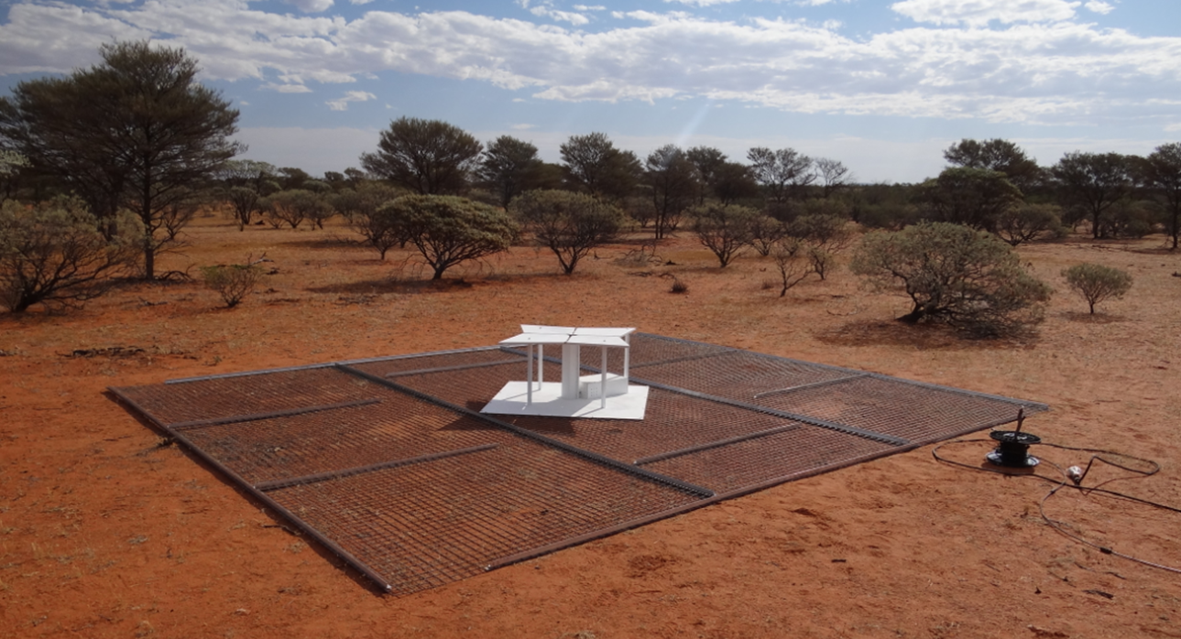
Methods
All data collected using the Experiment to Detect the Global EoR Signature (EDGES) radio telescope
Located at the Murchison Radio-astronomy Observatory (MRO) in Western Australia
Consists of a high band instrument sensitive to 100-200 MHz and a low land instrument sensitive to 50-100 MHz

Slide 5
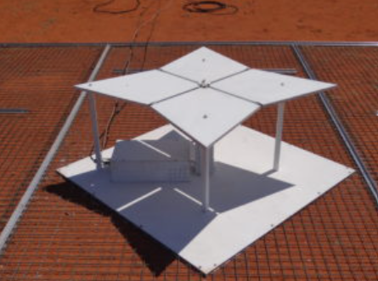
Procedure
Can track how the ionosphere and number of charged particles in the atmosphere change with time by comparing data from EDGES taken at same location in the sky and same LST (sidereal time) on different days
Radio emissions from our galaxy are background
Same part of astronomical sky is overhead at same LSTs so only difference must be from ionosphere

Slide 6
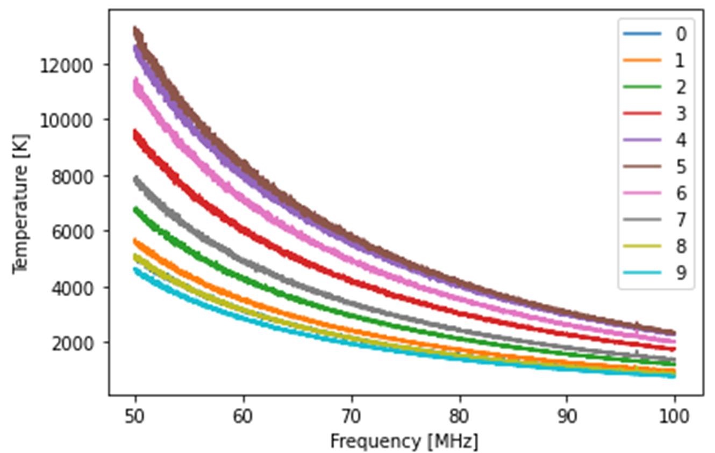
Results
Current script written for the code graphs different recorded spectra at different time intervals during a given day
Can also graph the difference between different spectra recorded at the same time on different days
Graph shows as time progresses and the temperature of the atmosphere changes, the power of the measured radio waves decreases
Each color is a successive spectrum taken 133 min apart

Slide 7
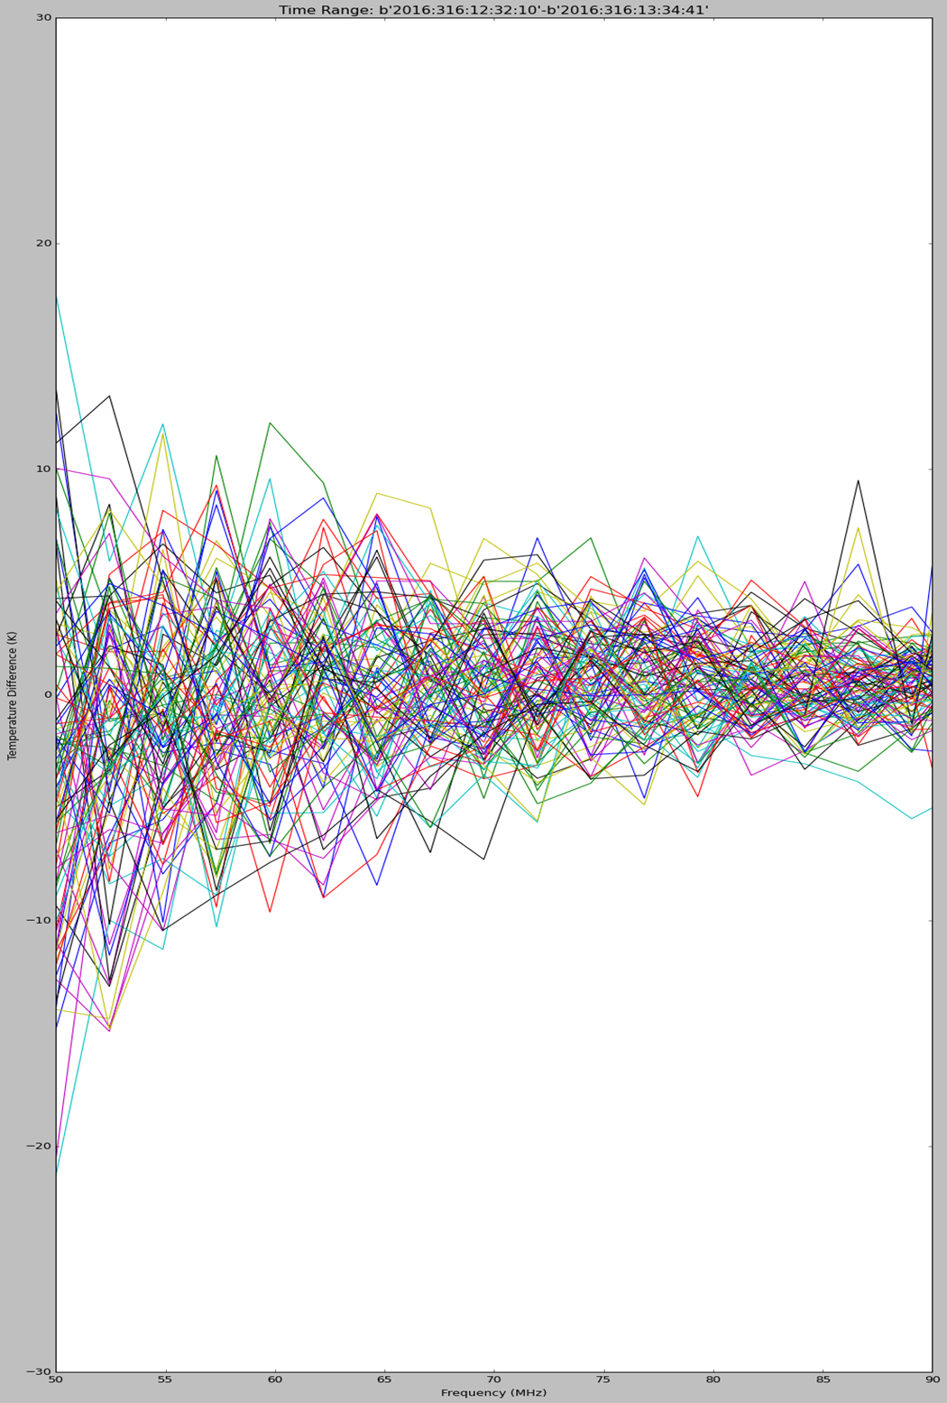
Difference Spectrum
Difference spectrum shows the temperature difference and recorded frequency from the 316th and 317th days of 2016 between 12:00 and 13:00 LST
Shows how the ionosphere affects the recorded radio frequencies from one day to the next day during the exact same time period
Not very strong signal since all curves stay close to zero on left side of graph

Slide 8
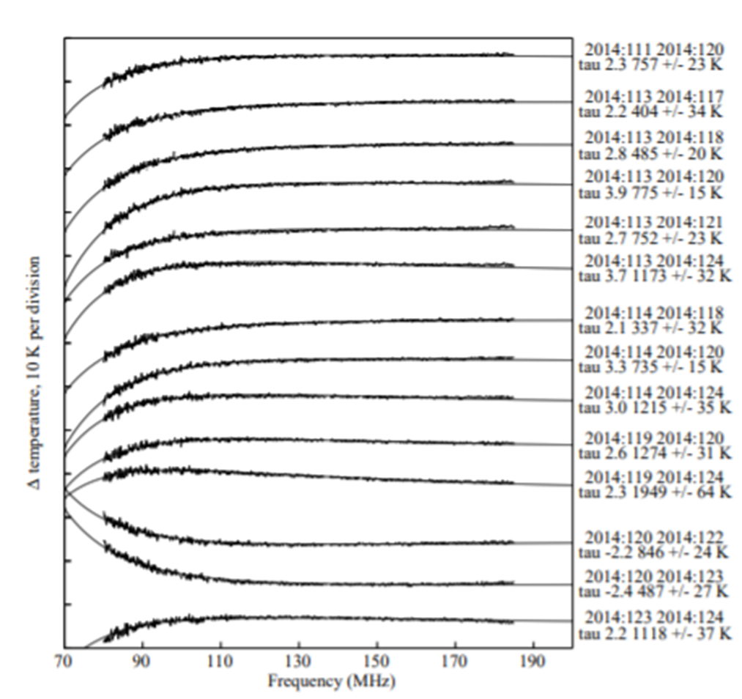
Next Steps
Will continue to work on coding script
Want to make more comparisons between different days in order to compare resulting difference spectra
Example goal difference spectrum of the largest ionospheric perturbations at the Galactic hour angle of 14 hours
DOI: 10.1002/2014RS005599 arXiv:1412.2255 [astro-ph.IM]

Slide 9
Acknowledgements
Dr. Judd Bowman
Akshatha Vydula
Nivedita Mahesh
Desiree Crawl
Margaret Hufford
Thomas Sharp
ASU/NASA Space Grant

Slide 10
Thank you

